Slide 1
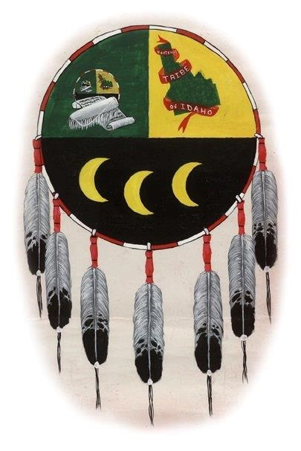

Understanding Our Climate Vulnerability:
A project by The Kootenai Tribe of Idaho
Presented by:
Annie Murai & Kara Odegard, Measure Meant
Karen Schumacher, Kootenai Tribe of Idaho
October 21, 2024

Slide 2




Climate Vulnerability Assessment &
Environmental Plan update
Fish
Land
Water
Air
Wildlife
Culture

Slide 3
Project Timeline
Climate Vulnerability Assessment
Environmental
Plan Update
October 2024 – June 2025

Slide 4
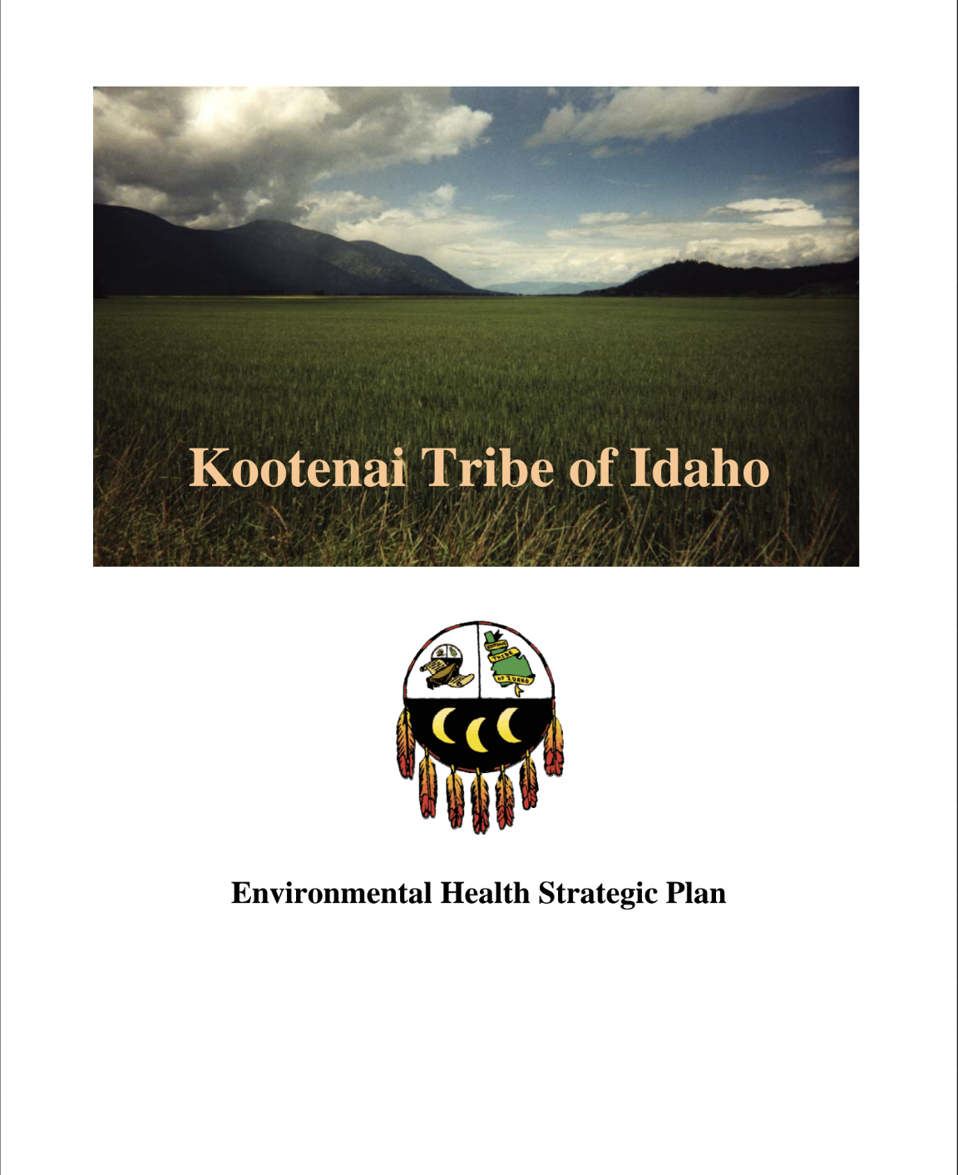
Environmental Plan Update
Kootenai Tribe’s Assessment Areas:
  Land
  Fish
  Wildlife
  Water
  Air
  Culture

Slide 5
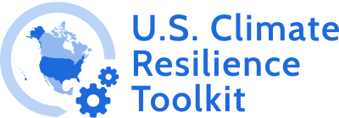
Vulnerability Assessment methodology
KTOI’s Assessment Areas:
Exposure
Sensitivity
  Land
  Fish
  Wildlife
  Water
  Air
  Culture
Potential Impact
Adaptive Capacity
Vulnerability
Methodology adapted from:

Slide 6



Future Climate Projections
Precipitation
Temperature
Wildfire
Streamflow

Slide 7
Questions?
Video break

Slide 8
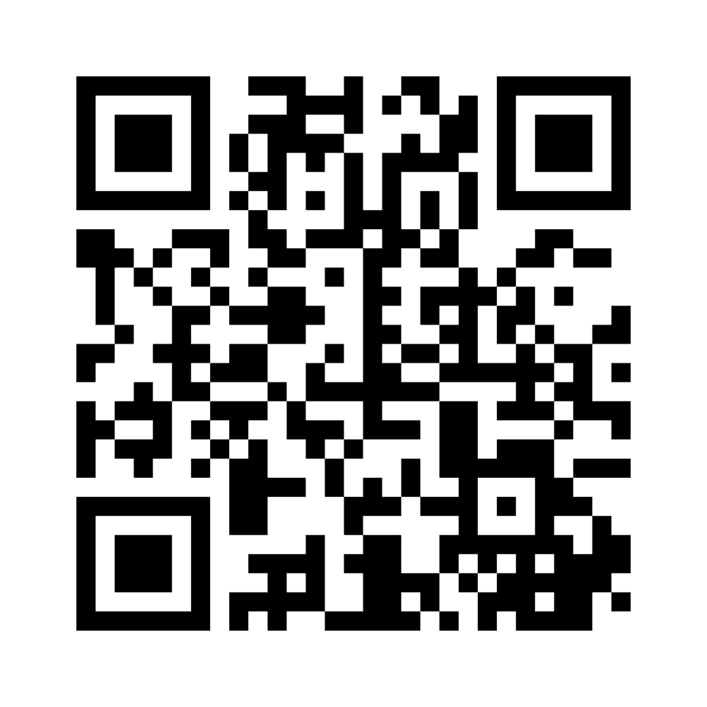
Please take our poll!
We’ll go question by question together

Slide 9
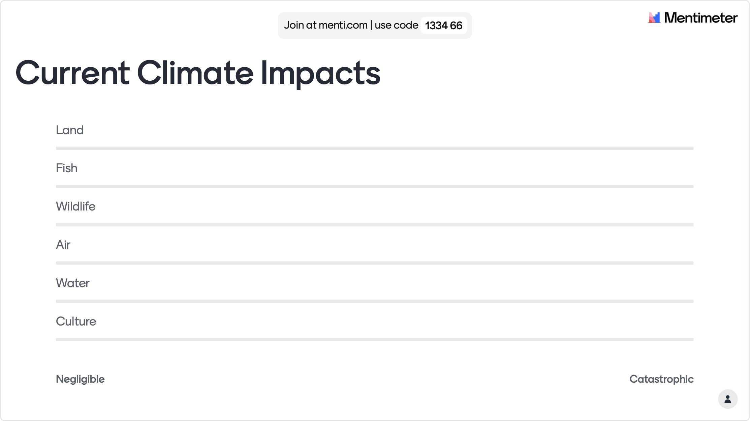

Slide 10
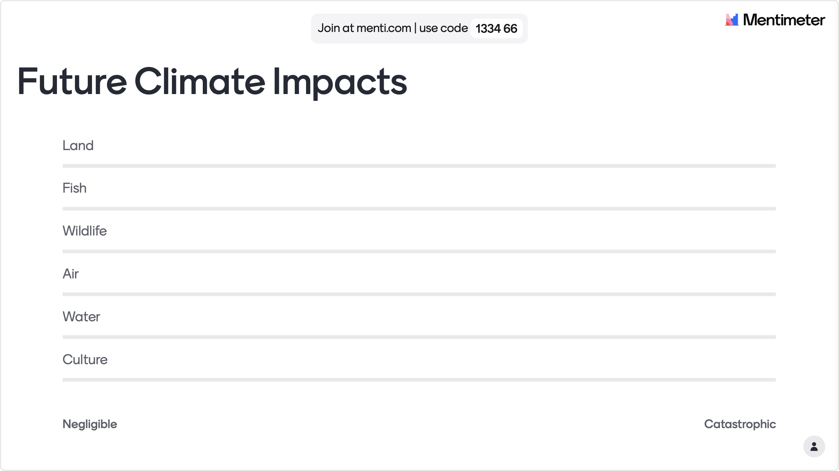

Slide 11
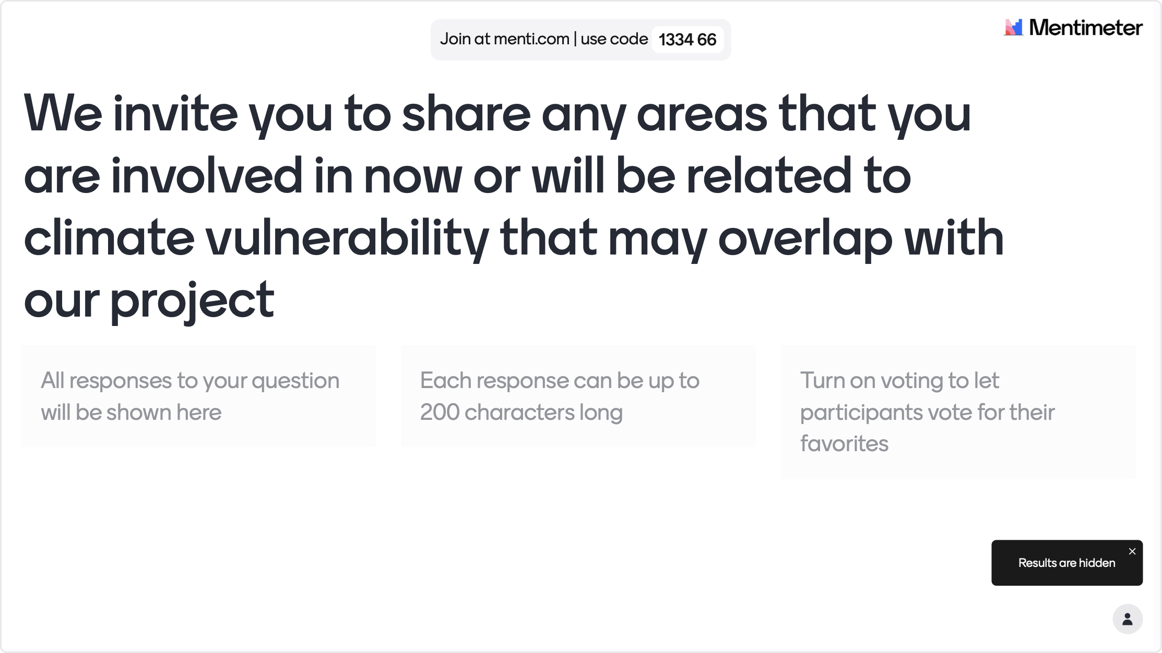

Slide 12
Thank you!
Contact us:
Annie Murai
annie@measurepnw.com
503-804-7940
Kara Odegard
kara@measurepnw.com
509-939-8665

