Slide 1
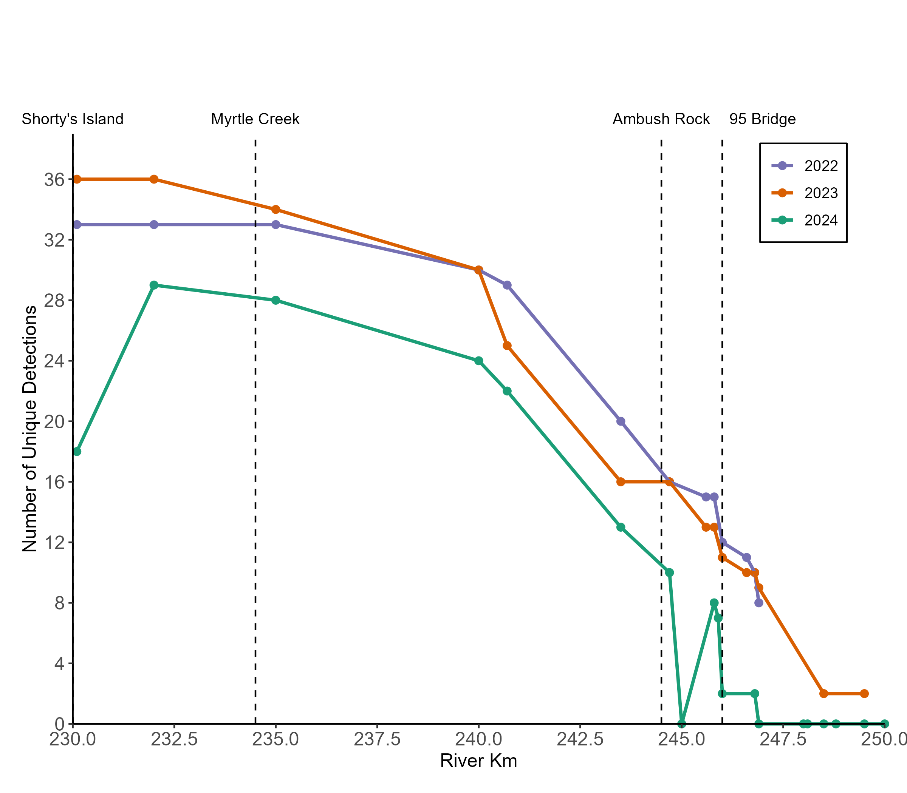
Kootenai River Sturgeon Spawning

Slide 2
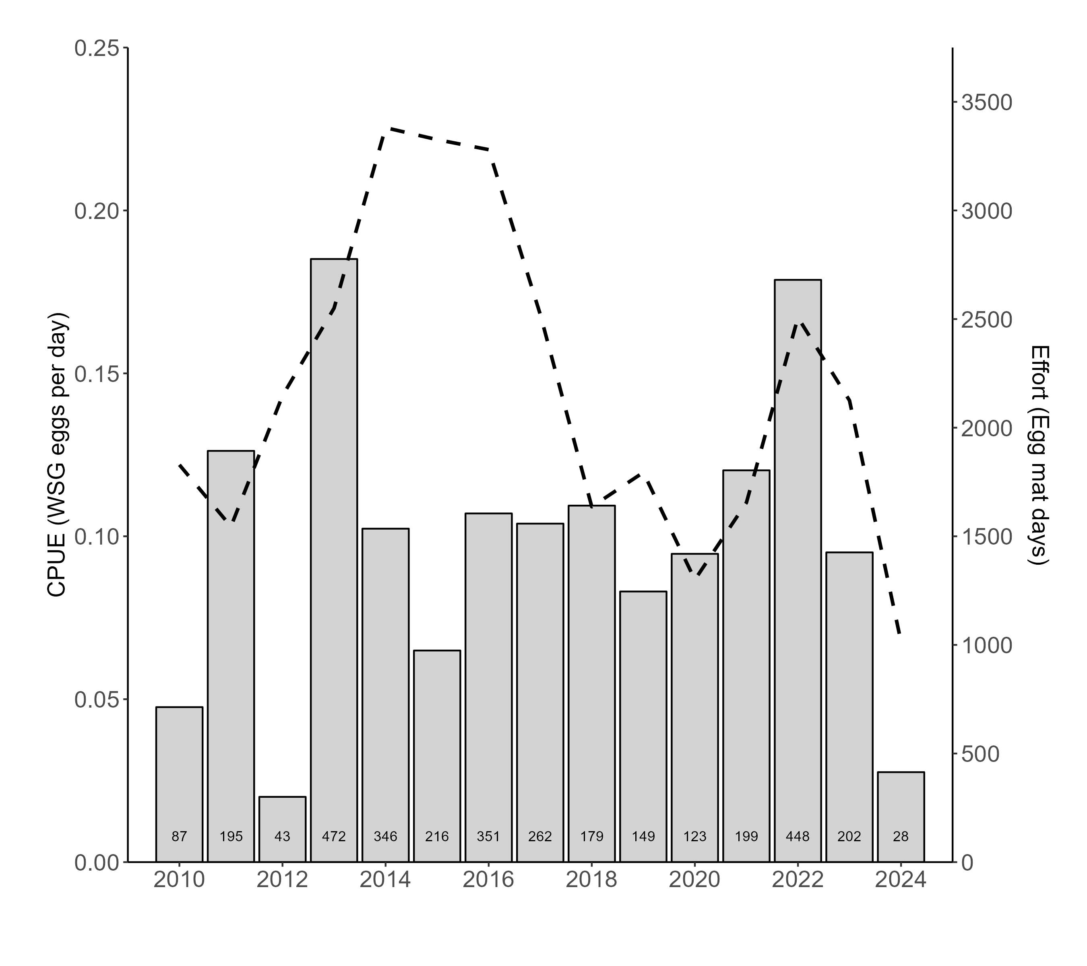
Kootenai River Sturgeon Spawning

Slide 3
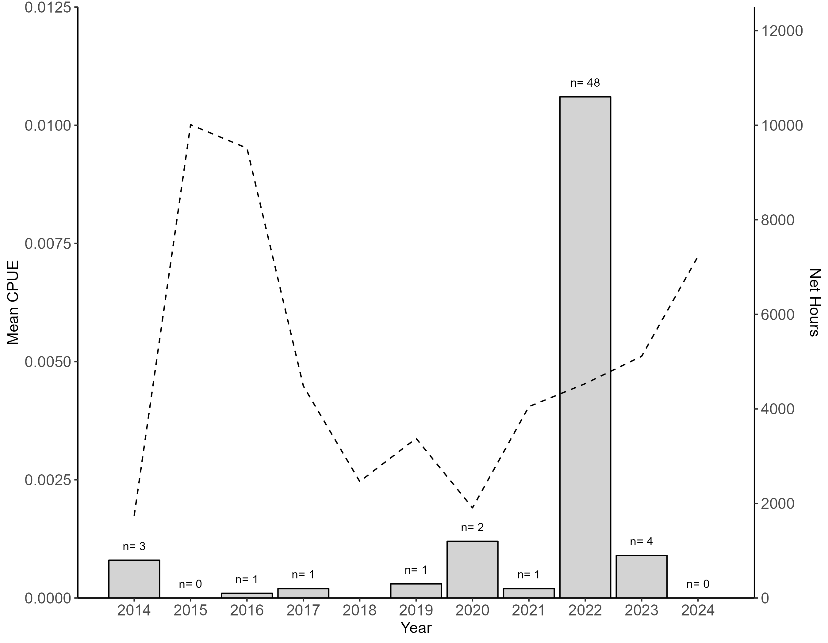
Kootenai River Sturgeon Spawning

