Slide 1
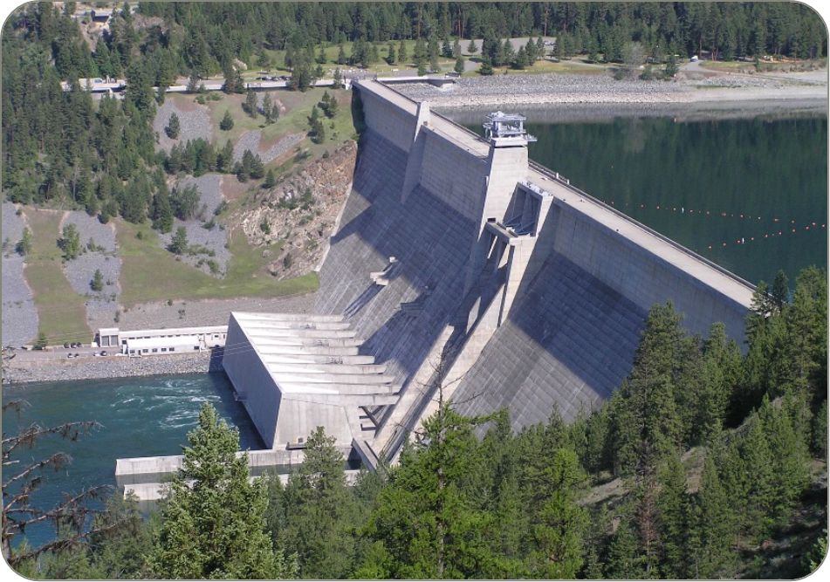
Libby dam operations water year 2024
Date: 21 October 2024
Leon Basdekas
Greg Hoffman

Slide 2
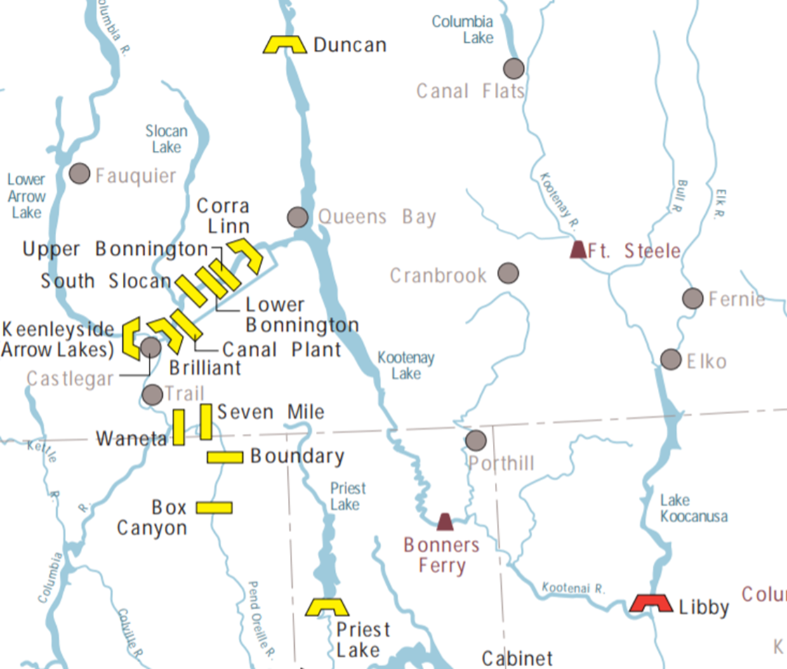
General background

Slide 3
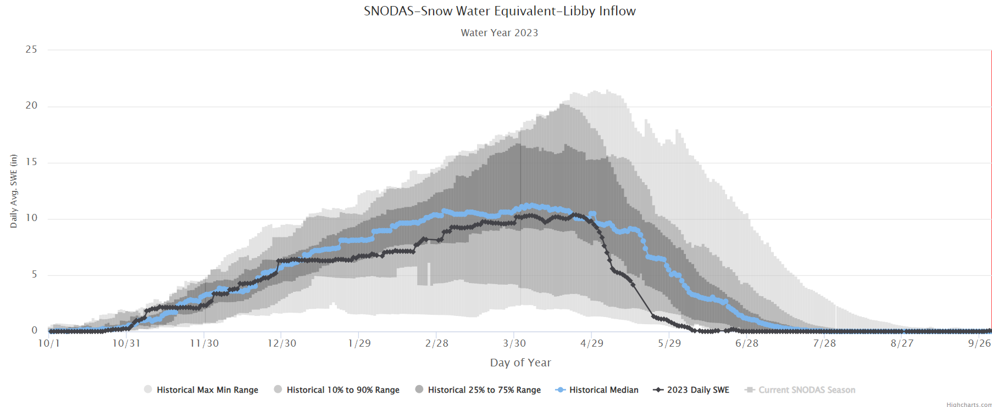
Libby May1 SWE ~83% of average

Slide 4
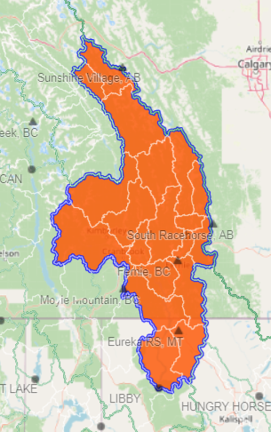
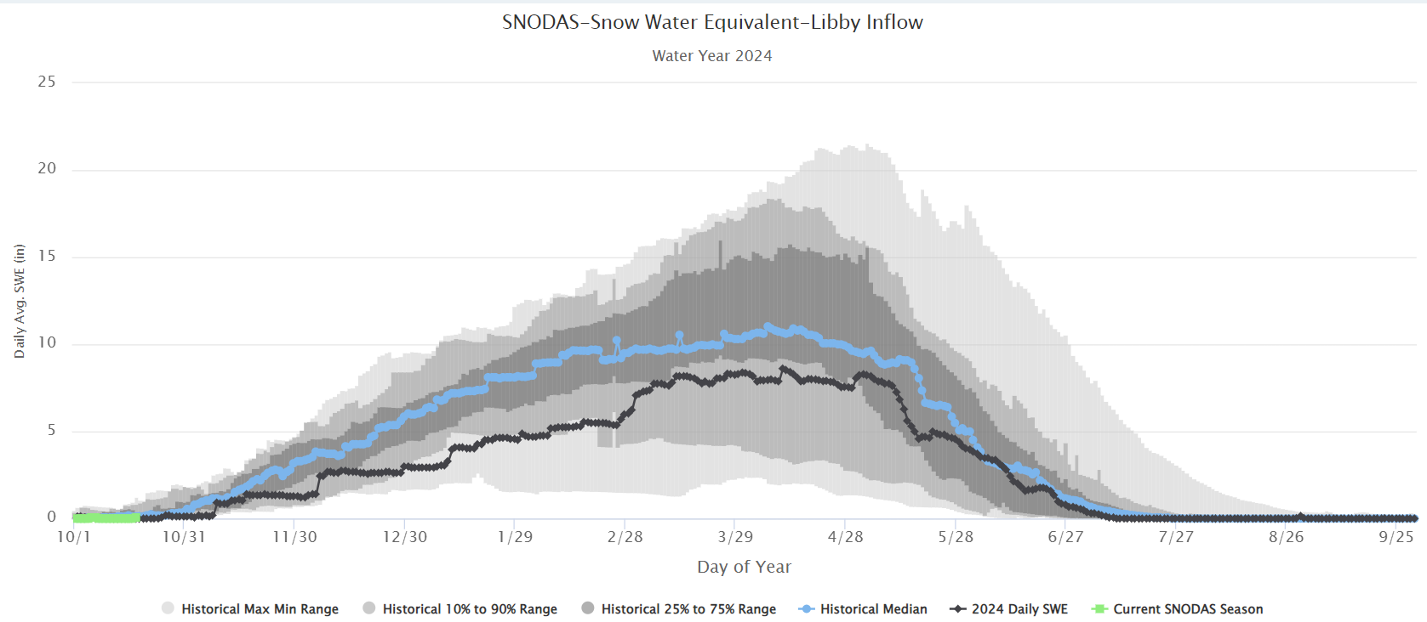
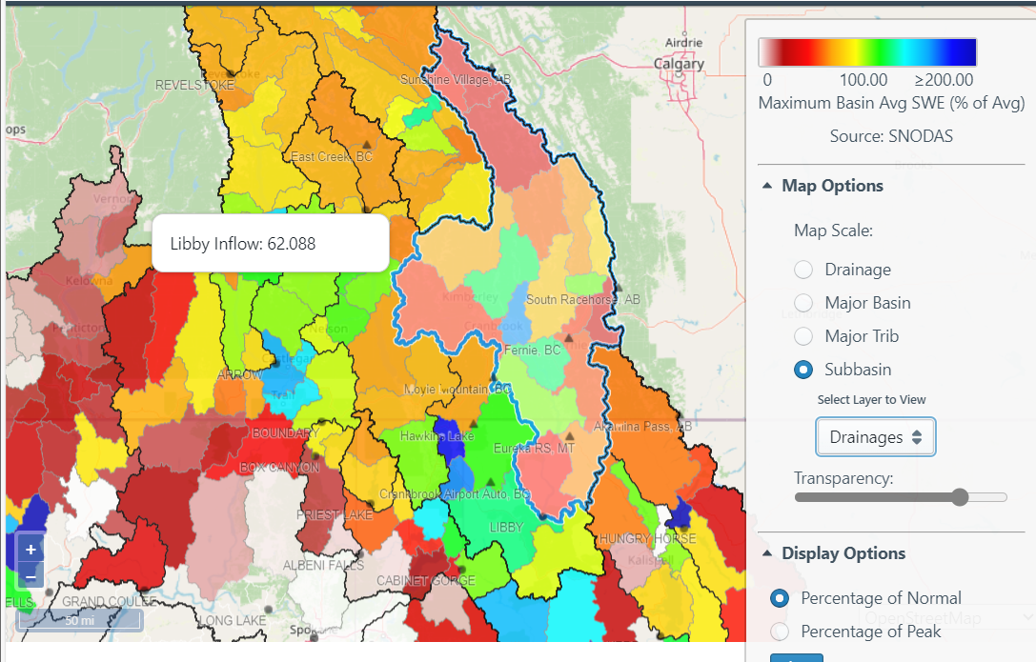
Basin snow
Libby May16 SWE ~62.1% of average
Libby May16 SWE ~62.1% of average

Slide 5
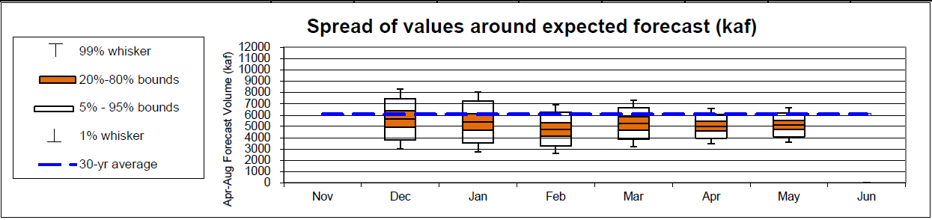
MAY 1st Water Supply Forecast and biop objectives
April-August inflow forecast for Libby Dam is 5.13 million acre-feet (MAF)
    Forecast is 82% of average
    Sturgeon Volume is 0.8 MAF
    Bull trout minimum flows following the Sturgeon Pulse through Aug 31 is 7 kcfs
  Libby Water Supply Forecast Trend:
    Libby flow augmentation draft to 10 ft from full (2449 ft) end of September

Slide 6
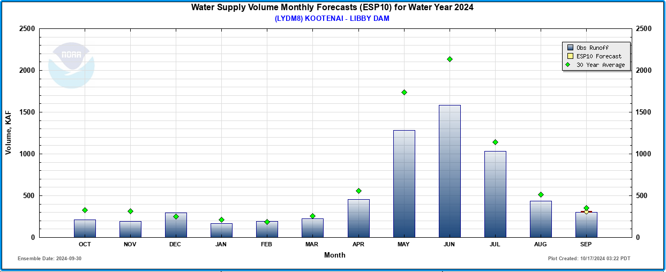
Observed inflows
4.788 Maf Apr – Aug. 79% of normal
6.387 Maf WY 2024 Oct. – Sept. 80% of normal

Slide 7
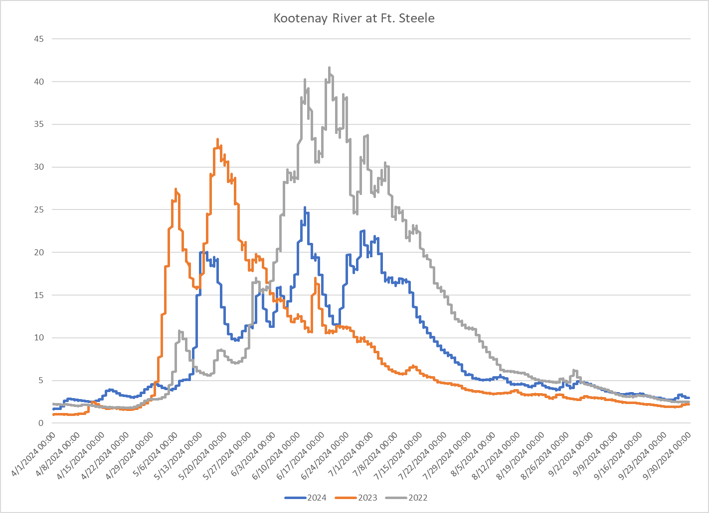
General background

Slide 8
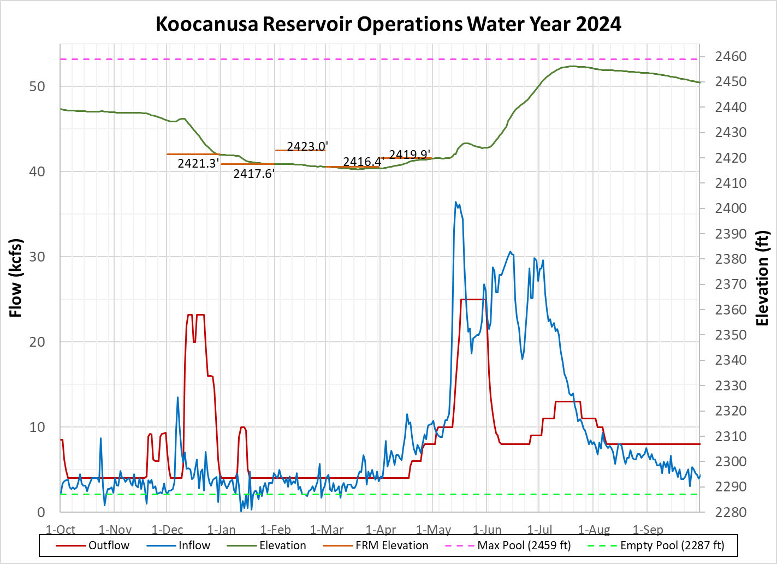
End Sept. 2449.68 ft
2449.0 ft 5 Oct.
20 July peak elevation 2456.14 ft
05 July outflows reduced to 8.0 kcfs
(Bull trout min 7 kcfs)
Notes:
Persistent high flows, even after snow sites appeared melted out.

Slide 9
Water year main points
Lake Koocanusa refilled to peak 2456.14 ft; 20 July
Meet end of September draft requirement of 2449.0 ft., on 5 October. Coordinated with TMT 11 September.
A significant amount of precipitation fell as rain rather than snow
Cool weather delayed snow melt.
Runoff persisted higher than forecast for most of spring and early summer
End of November lake elevation and corresponding river flow depend on unit 1 return to service date.

Slide 10
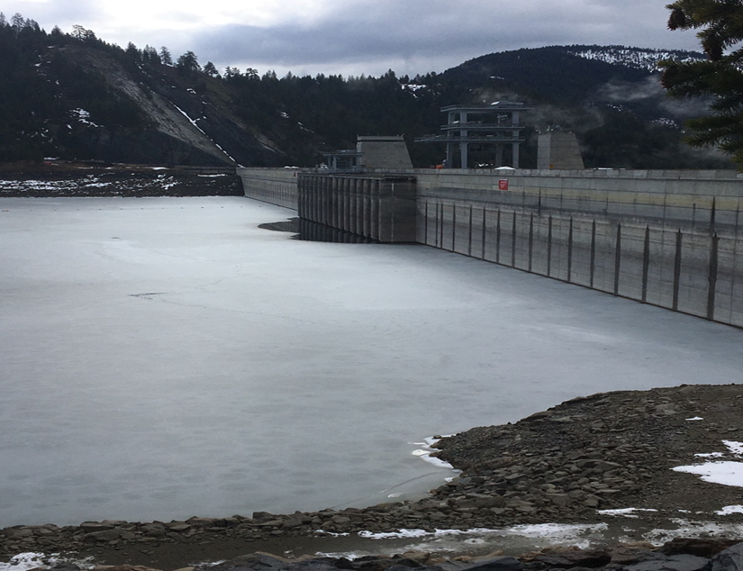
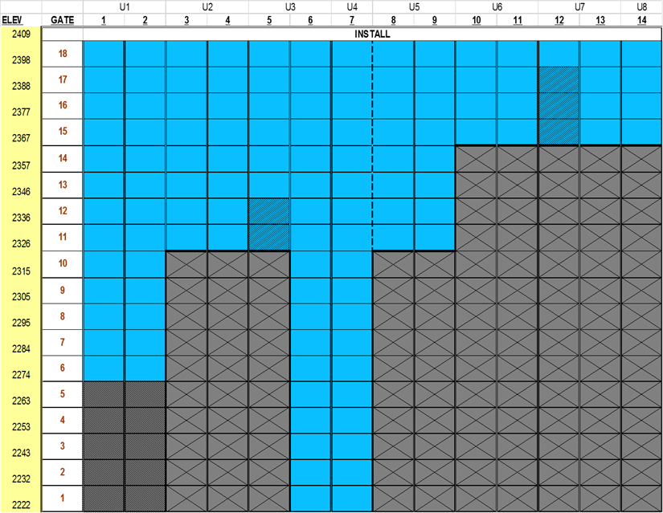
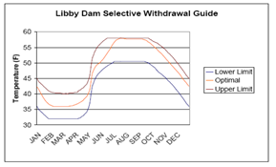
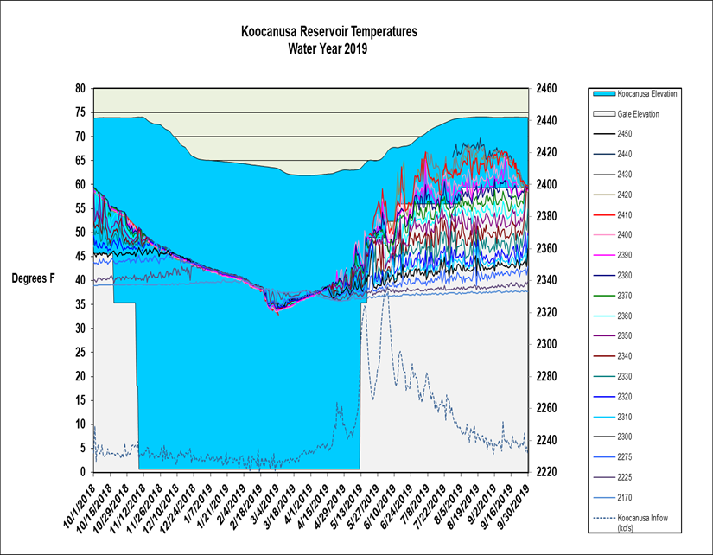
Libby dam selective withdrawal operations

Slide 11
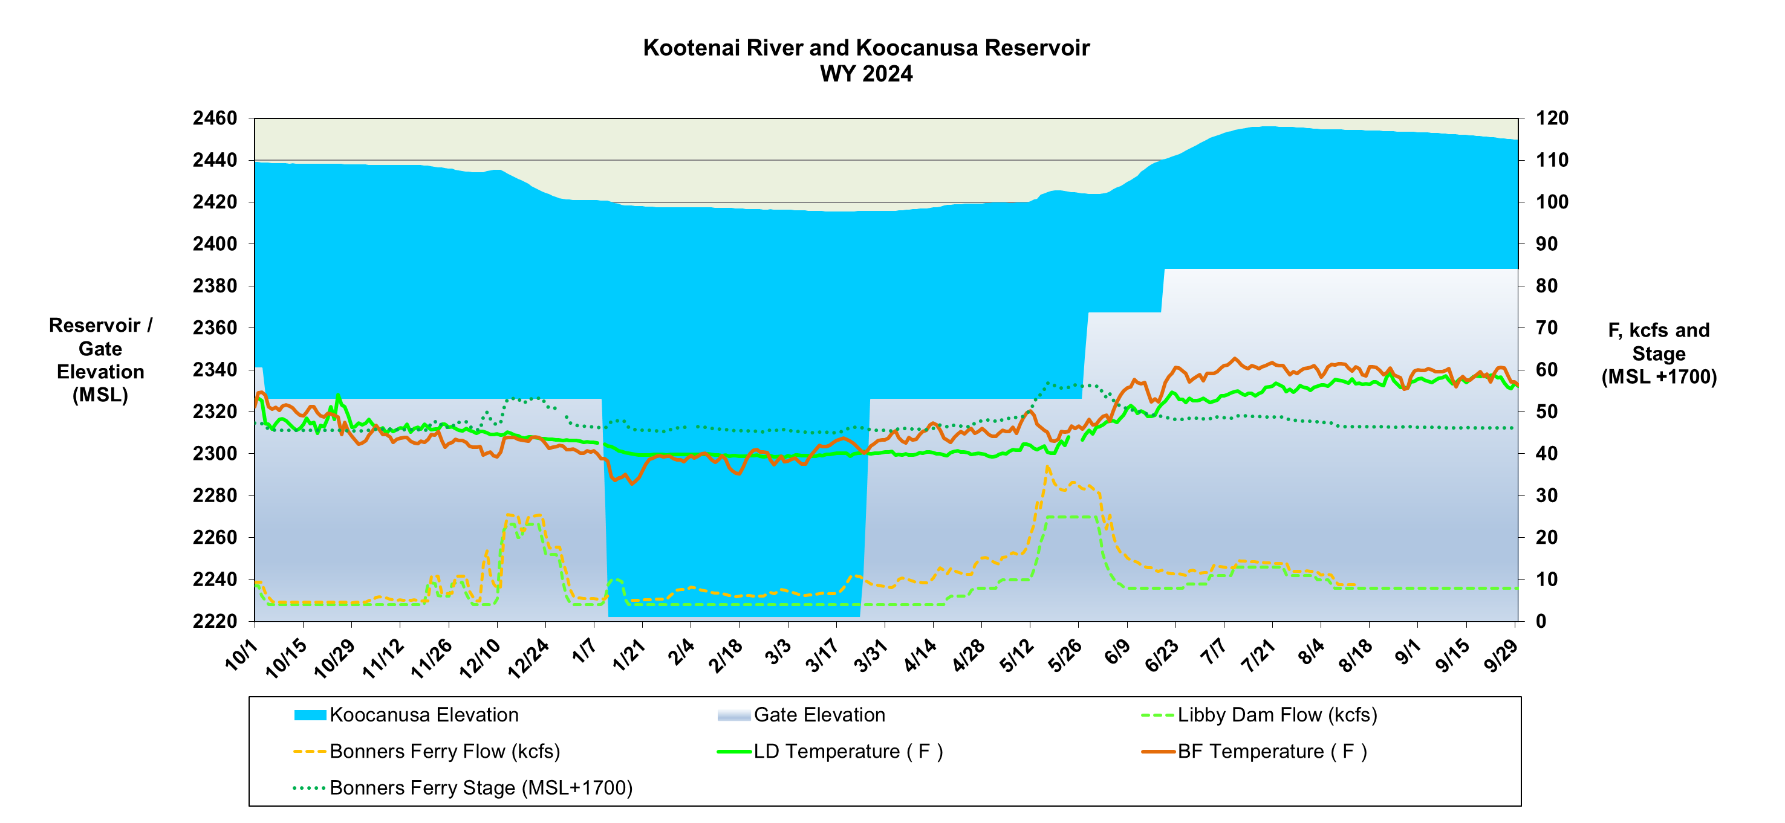

Slide 12
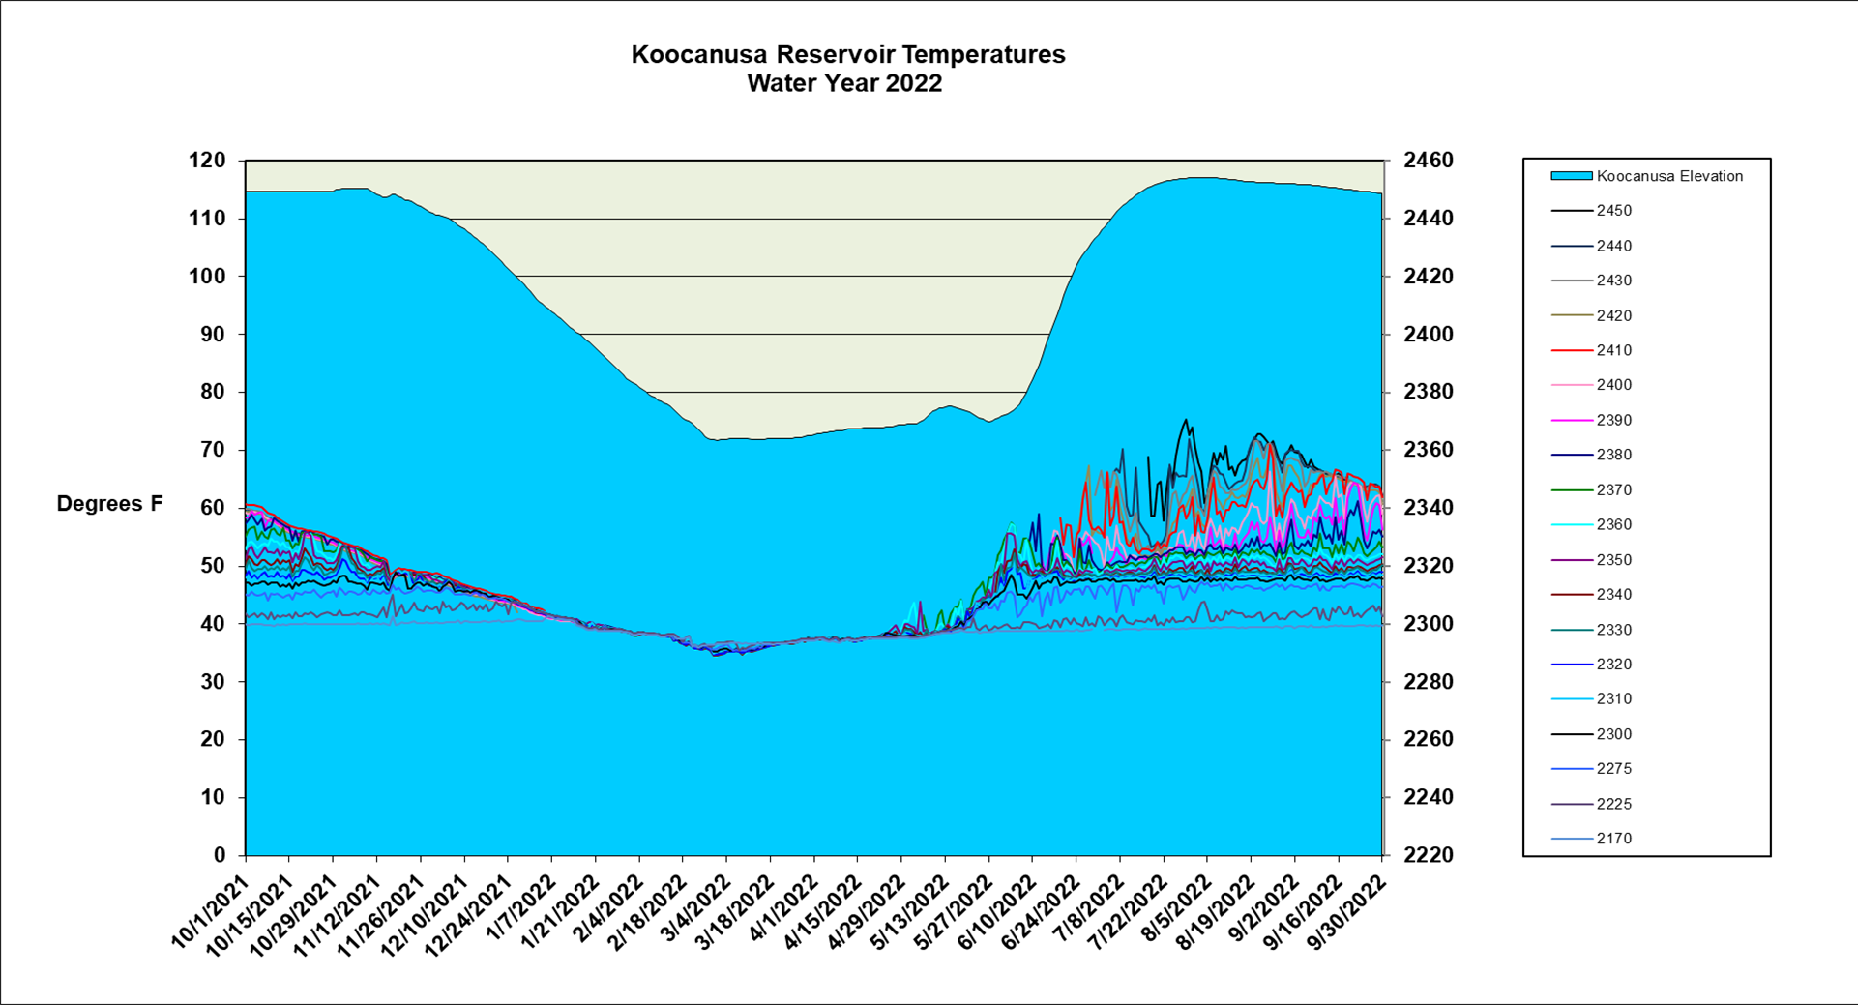

Slide 13
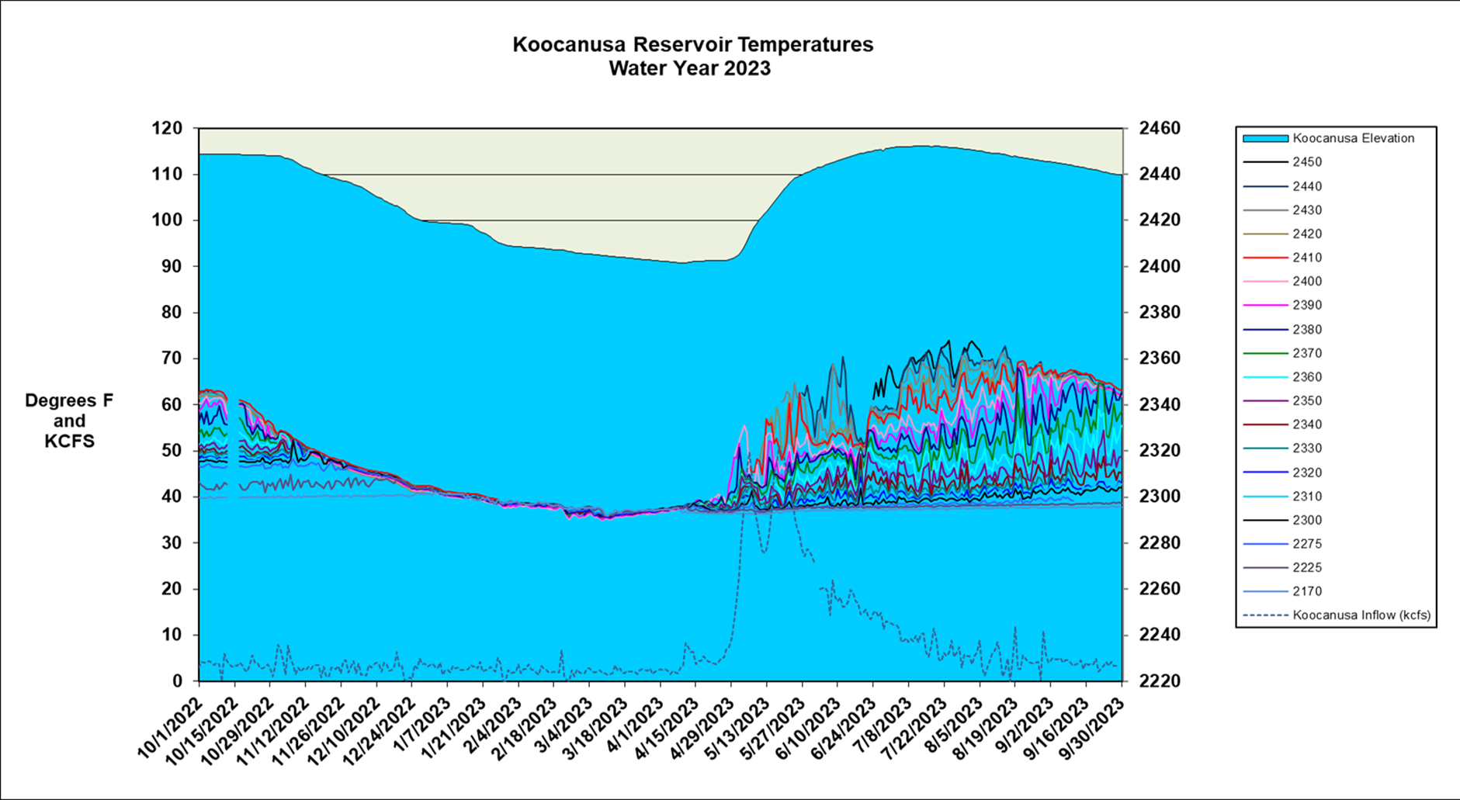

Slide 14
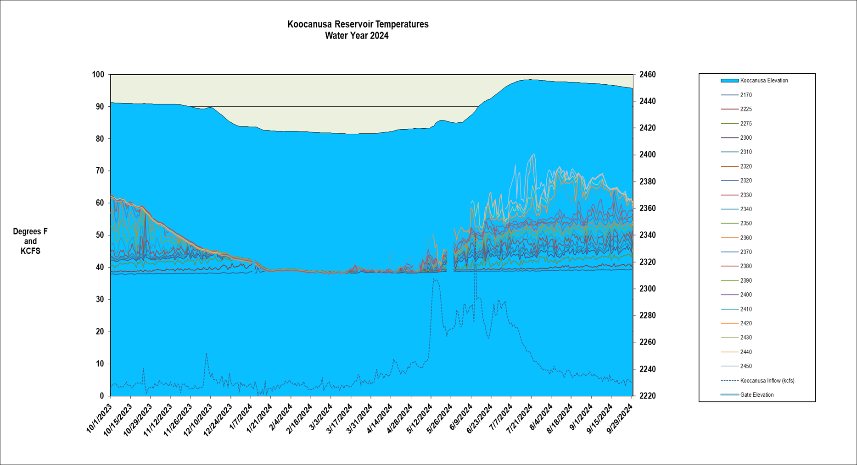

Slide 15

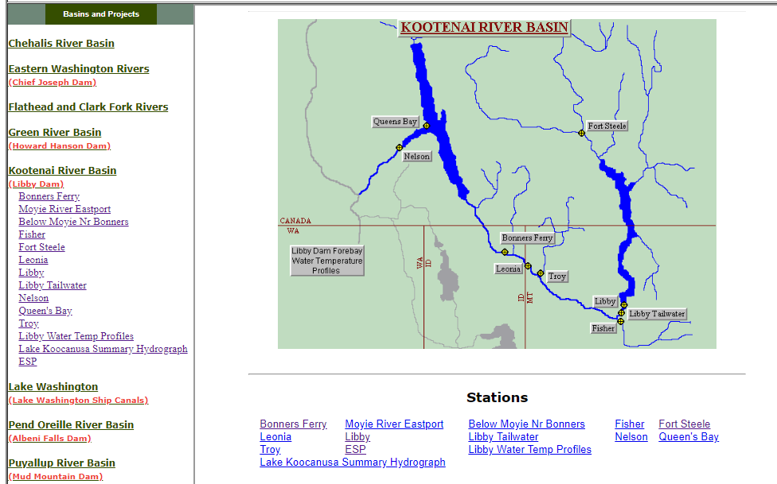
questions
For emails regarding release changes and lake level updates email
  UpperColumbiaWM@usace.army.mil
  Leon.Basdekas@usace.army.mil
General Queries call 206-764-6702
Seattle District water management data website :
http://www.nwd-wc.usace.army.mil/nws/hh/www/index.html#

Slide 16
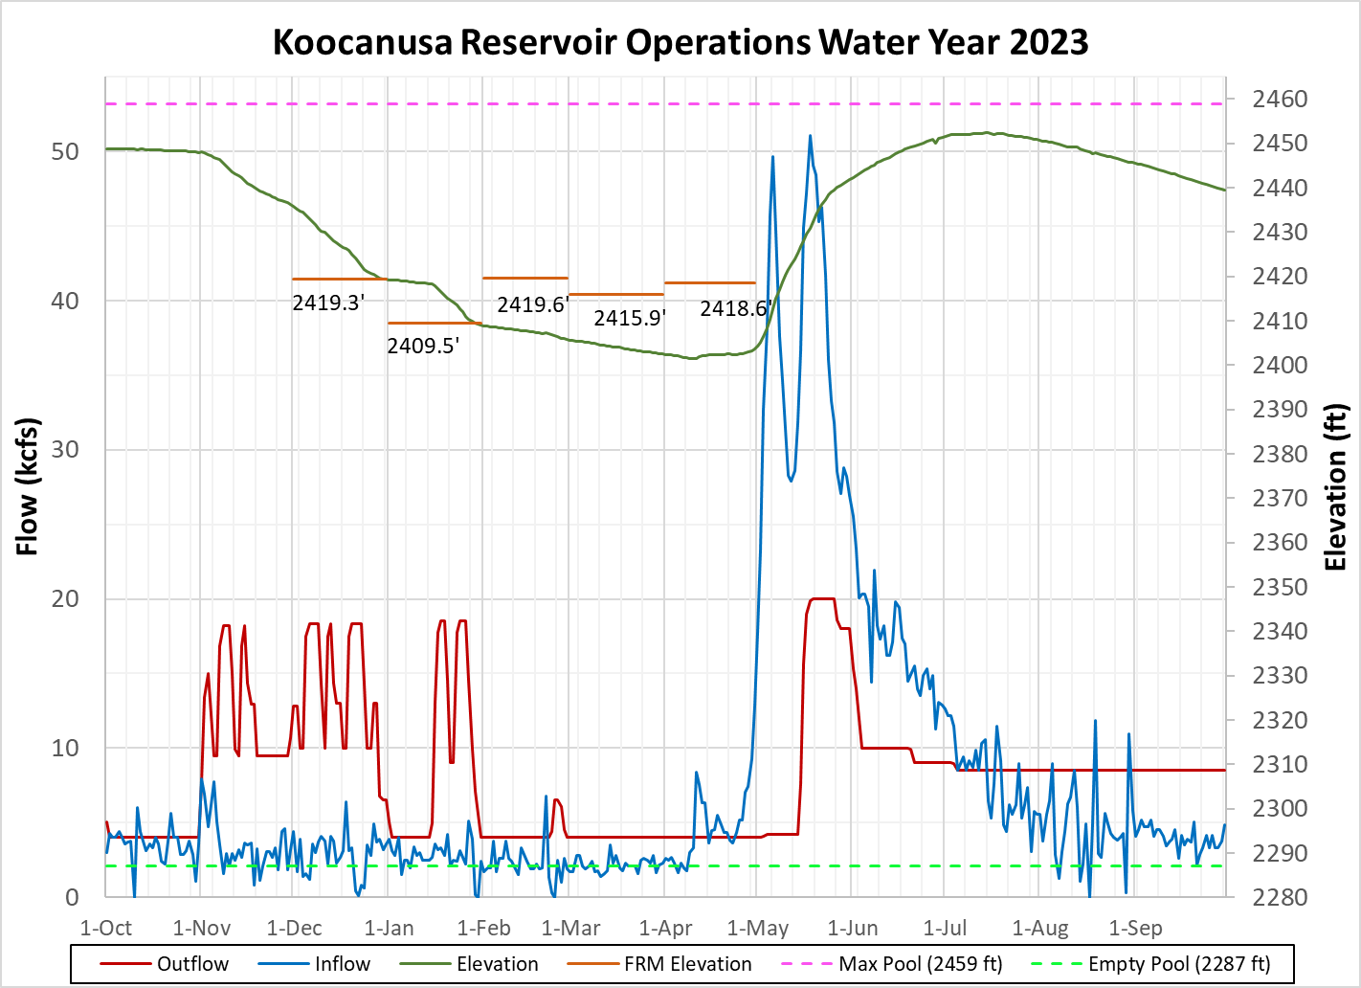
15 July peak elevation 2452.4 ft
End Sept. 2439.5 ft
05 July outflows reduced to 8.5 kcfs
(Bull trout min 6 kcfs)
Notes:
Lake Koocanusa reached its peak summer elevation on 15 July 2023 at 2,452.4 ft, which was 1.40 m (6.6 ft) below full pool.
Lake Koocanusa reached an elevation of 2439.5 ft at the end of the September. Lower BiOP lake elevation is the reason we kept flows so high during the summer. Bull trout min 6 kcfs.

